Slide 1

Credit Data
Defaulter versus Non-Defaulter

Slide 2
Problem Statement
The aim of this project is to build a predictive model to in order to capture the potential customers who are likely to Default or not pay their credit card bills.
The date/period of credit card dataset ranges from April 2005 to September 2005.
The raw data also contains the customer’s payment history, repayment status, Bill amount for that month, previous amount paid, his age as well as his education details.

Slide 3
OUR APPROACH FOR SOLUTION:
Excluding all the redundant data, rows with only zeros as well as empty transactions.
Captured the bill amount, amount paid and repayment status of a customer/month.
Customer having monthly transaction/row.
Implemented Feature Engineering for a custom status variable based on the repayment status.
Predicted the default list of customers.

Slide 4
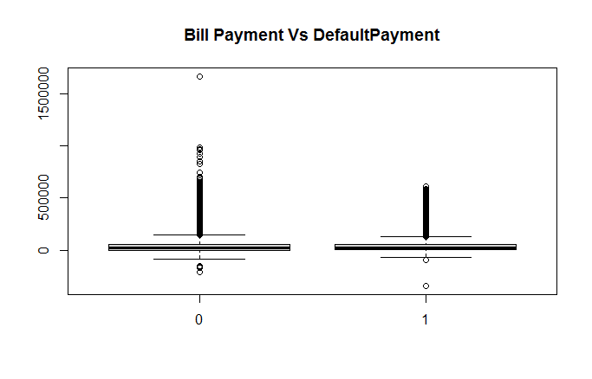
Data Cleaning and Wrangling:
Outlier Detection through Boxplots
Education data Handling
Credit Limit Factor (Taking a factor multiple for the Outlier detection)

Slide 5
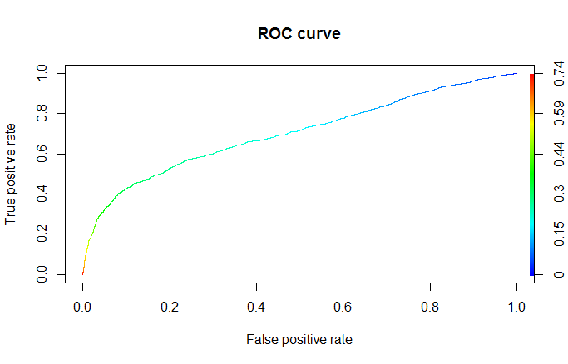
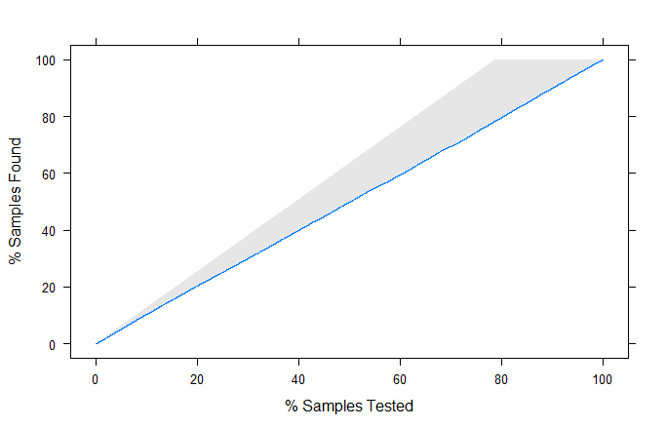
CLASSIFICATION MODELS
1. Logistic Regression Results
Confusion Matrix | 0 | 1
0 | 4978 | 807
1 | 786 | 713

Slide 6
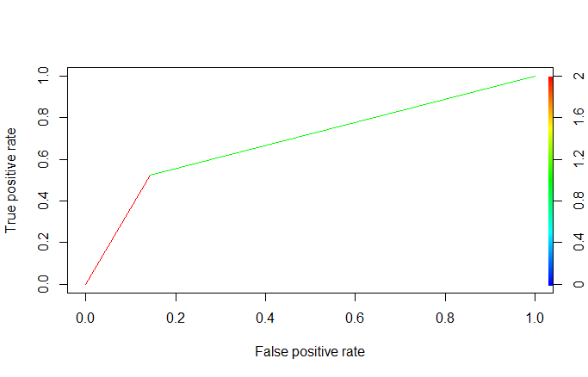
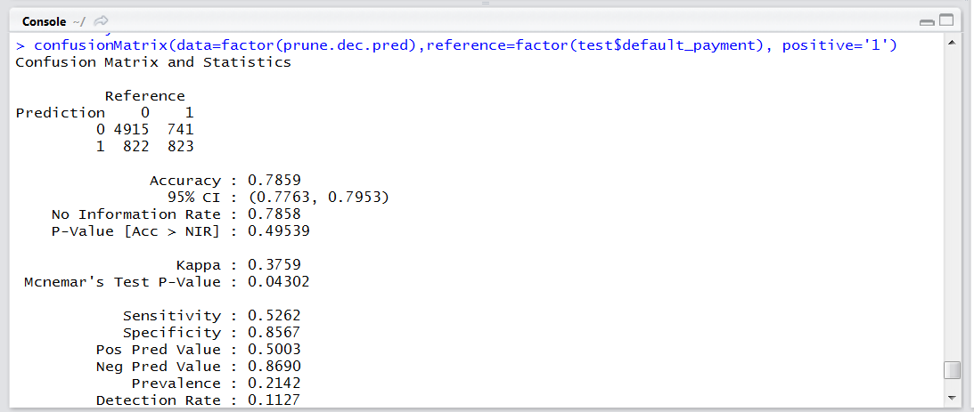
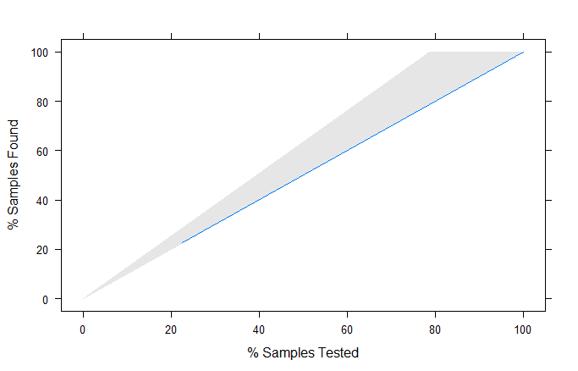
Decision Trees
Pruned Tree
Overall Error: 0.31
Confusion Matrix

Slide 7

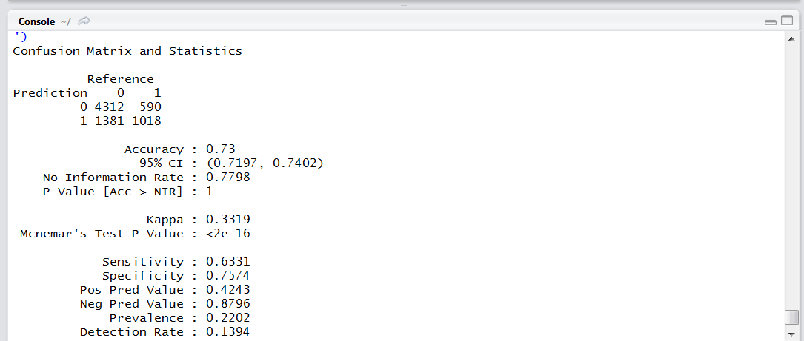
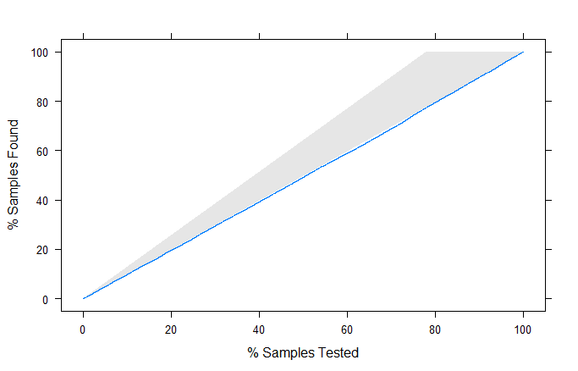
Neural Network
Overall Error: 0.32

Slide 8
Models Evaluation
For this case scenario Neural Networks is our best model.
Accuracy of 73%
Sensitivity of 63%
Specificity of 76%.

Slide 9
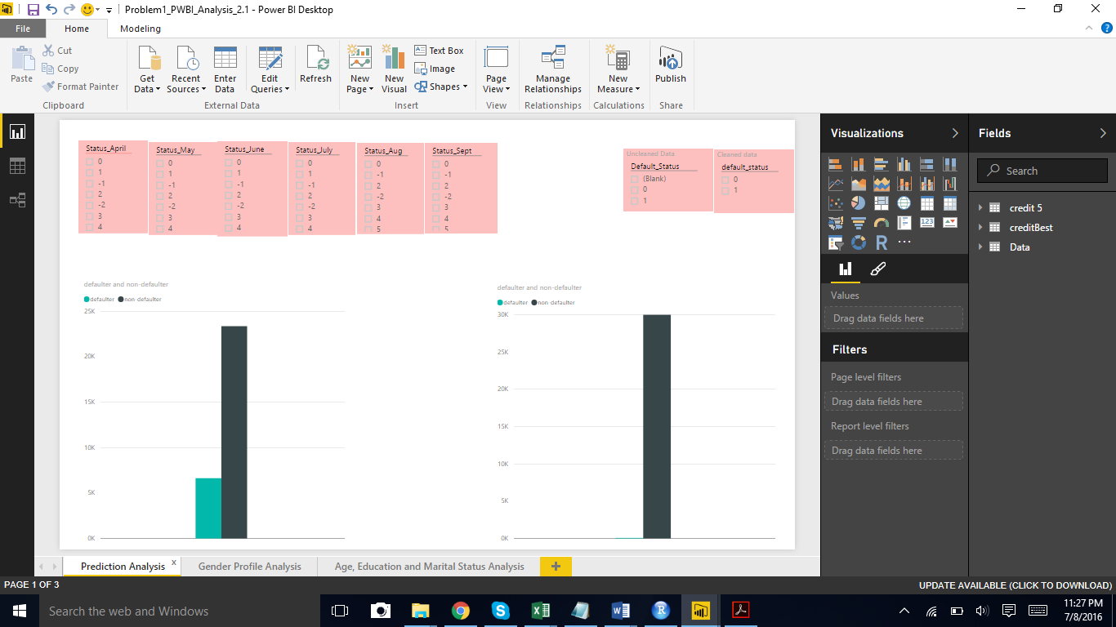
Prediction Analysis – Power BI
Comparison of Expected and Predicted Results

